Slide 1
Rajeev Institute of Technology Department of Computer Science & Engineering Final Year Project Zeroth Phase Presentation On
”Tobacco Leaves Grading System using Image Processing.”
Submitted By:
Likith Gowda H 4RA16CS037
Rajath S Koushik 4RA16CS072
Rakesh Gowda R 4RA16CS073
Uzair Ahmed 4RA16CS102
Guided By:
Mrs.Sangeetha.S
Assistant professor
Department of CSE
RIT, Hassan

Slide 2
Abstract
A grading system based on image processing techniques will be developed for automatically inspecting and grading flue-cured tobacco leaves
Classification is done on three major classes namely class-1, class-2 and class-3 for obtaining global efficiency on the test set consisting about images of each cluster.
Proposed Tobacco Leaves Classiﬁcation System performance even on limited training samples (image data set) compared to existing models

Slide 3
Introduction
Tobacco is one of the most successful commercial crops cultivated on this planet. China, India, Brazil and USA are the major producers of tobacco worldwide
Quality inspection of tobacco leaves plays a crucial role in quality assurance of tobacco productions
At present, the grading process is performed manually throughout the world.
If we can use machine vision technology and design algorithms to grade tobacco leaves automatically.

Slide 4
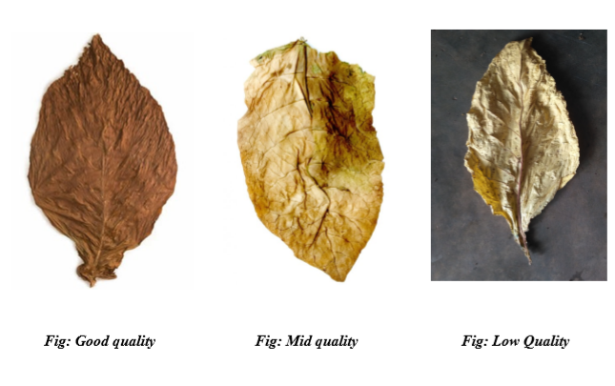
Figures

Slide 5
Literature Survey
Zhang, J.; Sokhansanj, S.; Wu, S.; Fang, R.; Yang, W.; Winter, P. A trainable grading system have proposed system which ﬁnds size of diﬀerent fruits and accordingly diﬀerent fruits can be sorted using fuzzy logic.
Garcia, M.; Barreiro, P.; Ruiz, A.M.; Alonso, R.; Judez, L. Development of a virtual expert for color classiﬁcation of tobacco leaves have presented a study on colour image processing based intelligent fruit sorting system. In this he used Fruit sorting by classic Bayes classiﬁer, whose parameters were obtained by a study module.
MacCormac, J. On-line image processing for tobacco grading in Zimbabwe. In Proceedings of IEEE International Symposium on Industrial Electronics, deﬁne the process of colour classiﬁcation, it involves extraction of useful information concerning the spectral properties of object surfaces and discovering the best match from a set of known descriptions or class models to implement the recognition task.

Slide 6
Problem Statement
Most of the classiﬁcation and the quality evaluation of the tobacco leaves are manually operated. It is a rigorous task.
Also eﬃciency and the stability of error rate are not satisfying enough.
New technology and equipments are needed to automate the quality inspection process of tobacco leaves.

Slide 7
Goals and Objective
Our project is to ﬁnd a feasible method to realize the automatic grading of tobacco leaves
This system is developed to recognize quality of leaves more accurately.
It classifies the leaves as Quality 1, Quality 2 based on shape, colour and texture.

Slide 8
Methodology
Machine learning (ML) is the scientiﬁc study of algorithms and statistical models that computer systems use to eﬀectively perform a speciﬁc task without using explicit instructions, relying on patterns and inference instead
Python is an interpreted high-level programming language for general-purpose programming.
Image processing is a method to convert an image into digital form and perform some operations on it, in order to get an enhanced image or to extract some useful information from it.
Features are the information that are extracted from an image. These are realvalued numbers (integers, ﬂoat or binary).

Slide 9
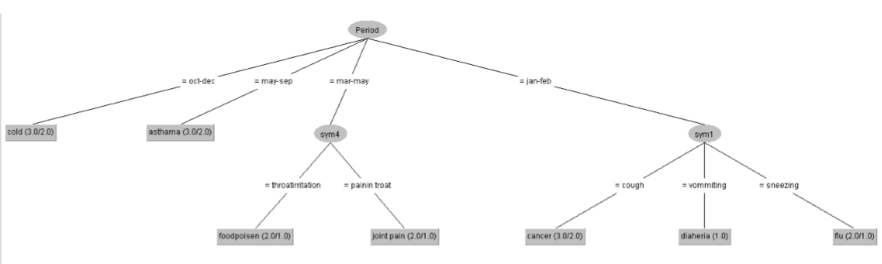
Decission Tree Algorithm

Slide 10
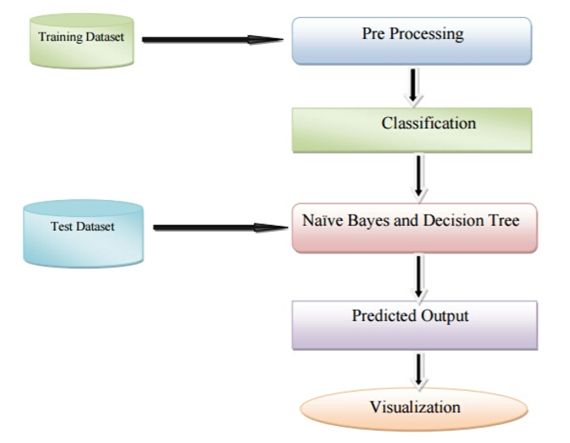
Flowchart

Slide 11
Requirement Specification
Hardware requirements:
Processor : Pentium or above
Processor Speed : 1.6Ghz and above
RAM : 4GB and above
Storage Space : Approx. 5 GB
Software requirements:
Operating System : Windows7 & above or Linux
Language : Python
Libraries : Python Libraries
Developing software : Anaconda / Spyder

Slide 12
References
References:
1.https://scholar.google.com
2.https://ieeeexplorer.net
3.https://stackoverflow.com
4.https://github.com
Base Papers :
[1]Leaf Disease Grading by Machine Vision and Fuzzy Logic
[2] Factors Influencing Tobacco Leaf Quality an Investigation of the Literature

Slide 13
Thank You

